Slide 1
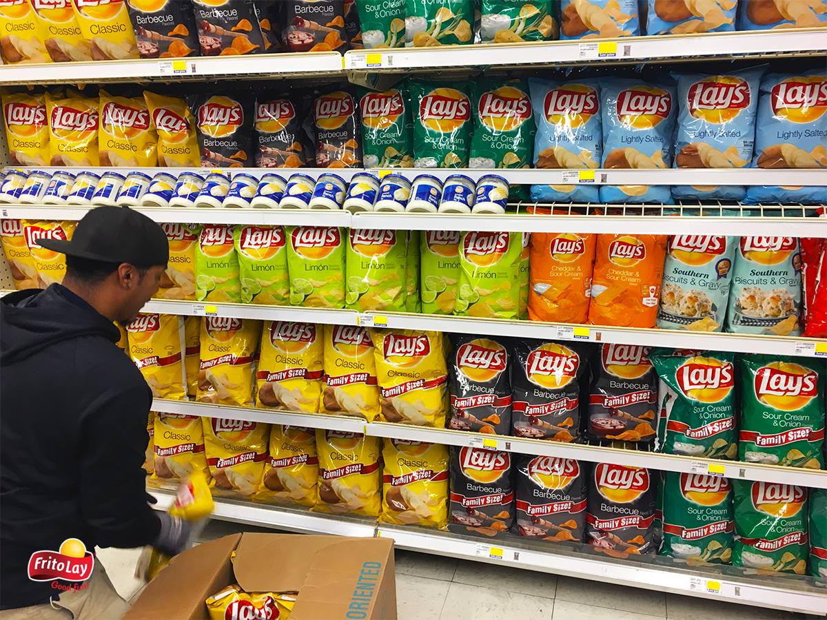
Frito-Lay Prospects
Final Presentation for DSO 570
05/08/2019

Slide 2

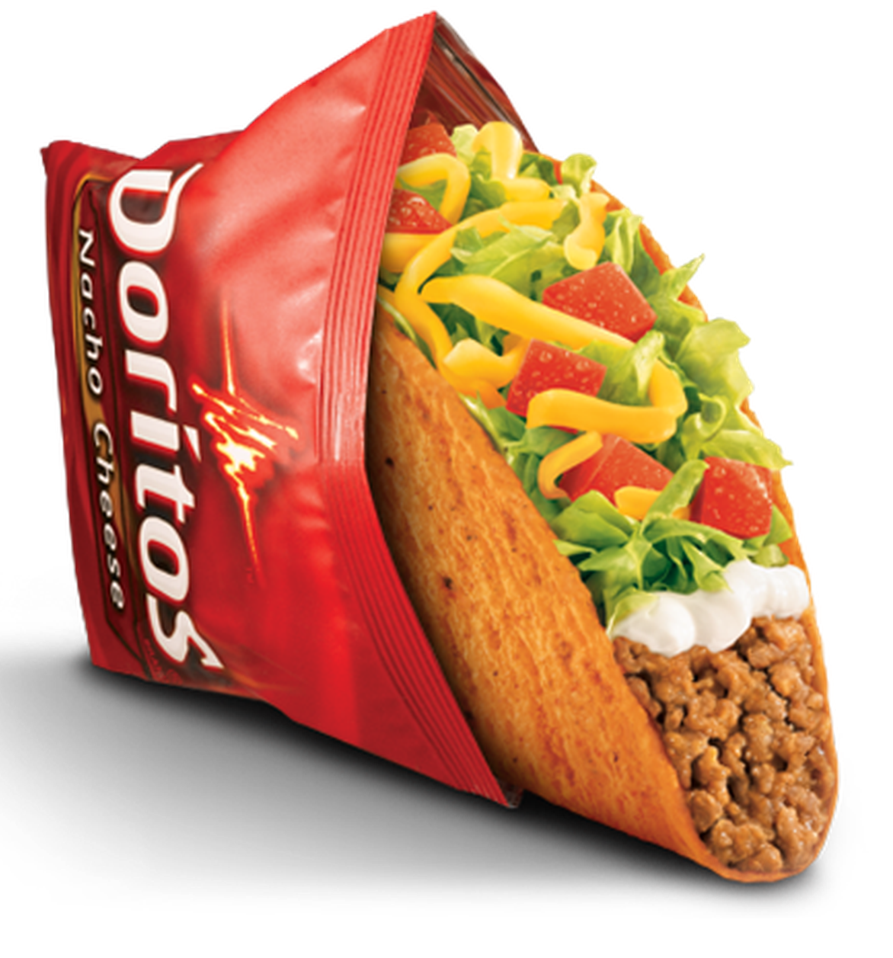
Agenda
Problem Statement
Data Exploration
Model Explanation
Result Interpretation
Future Improvement
1
2
3
4
5

Slide 3
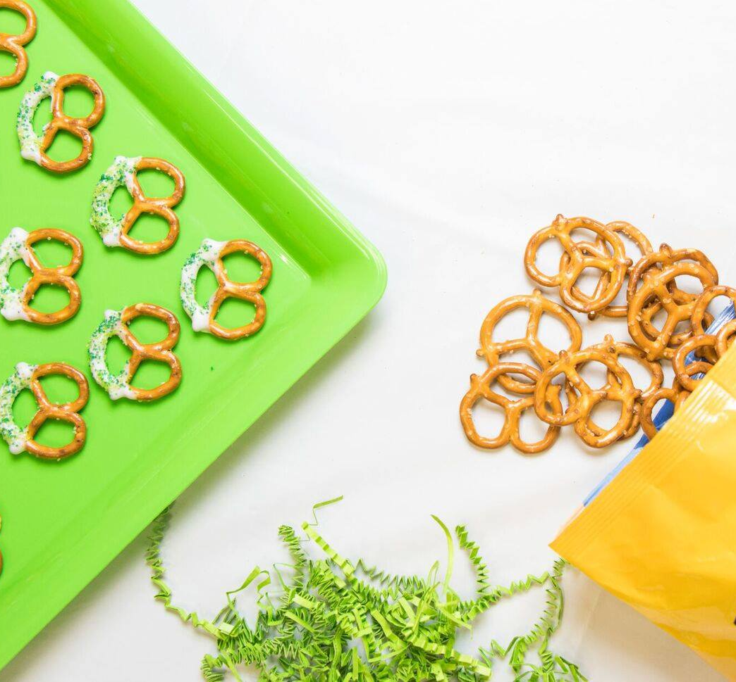
Problem Statement

Slide 4

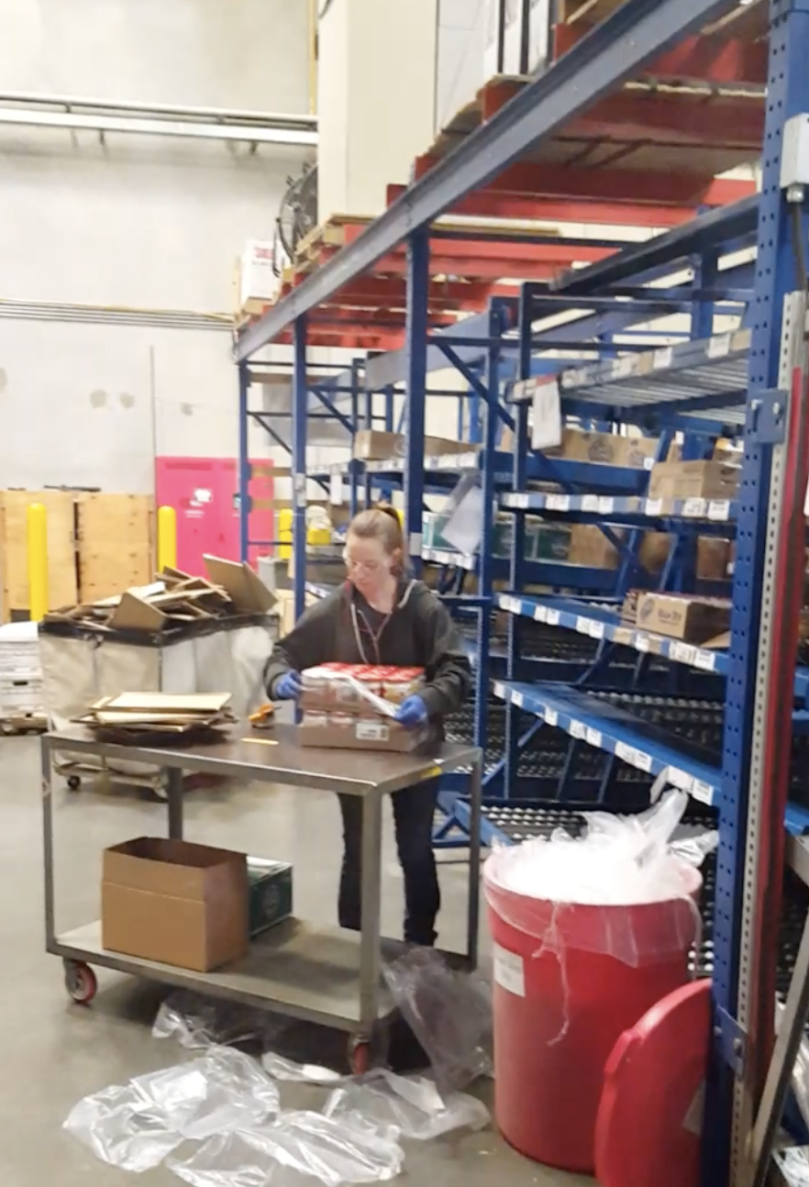






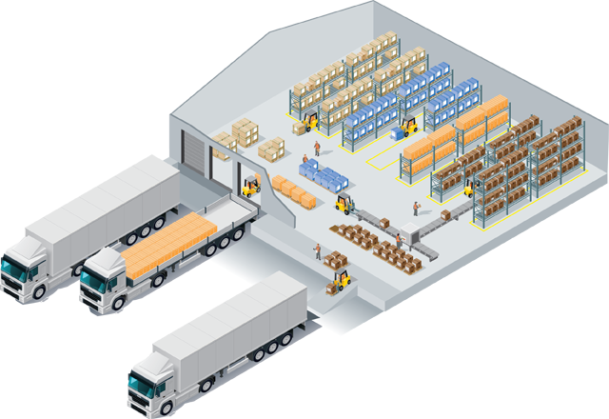
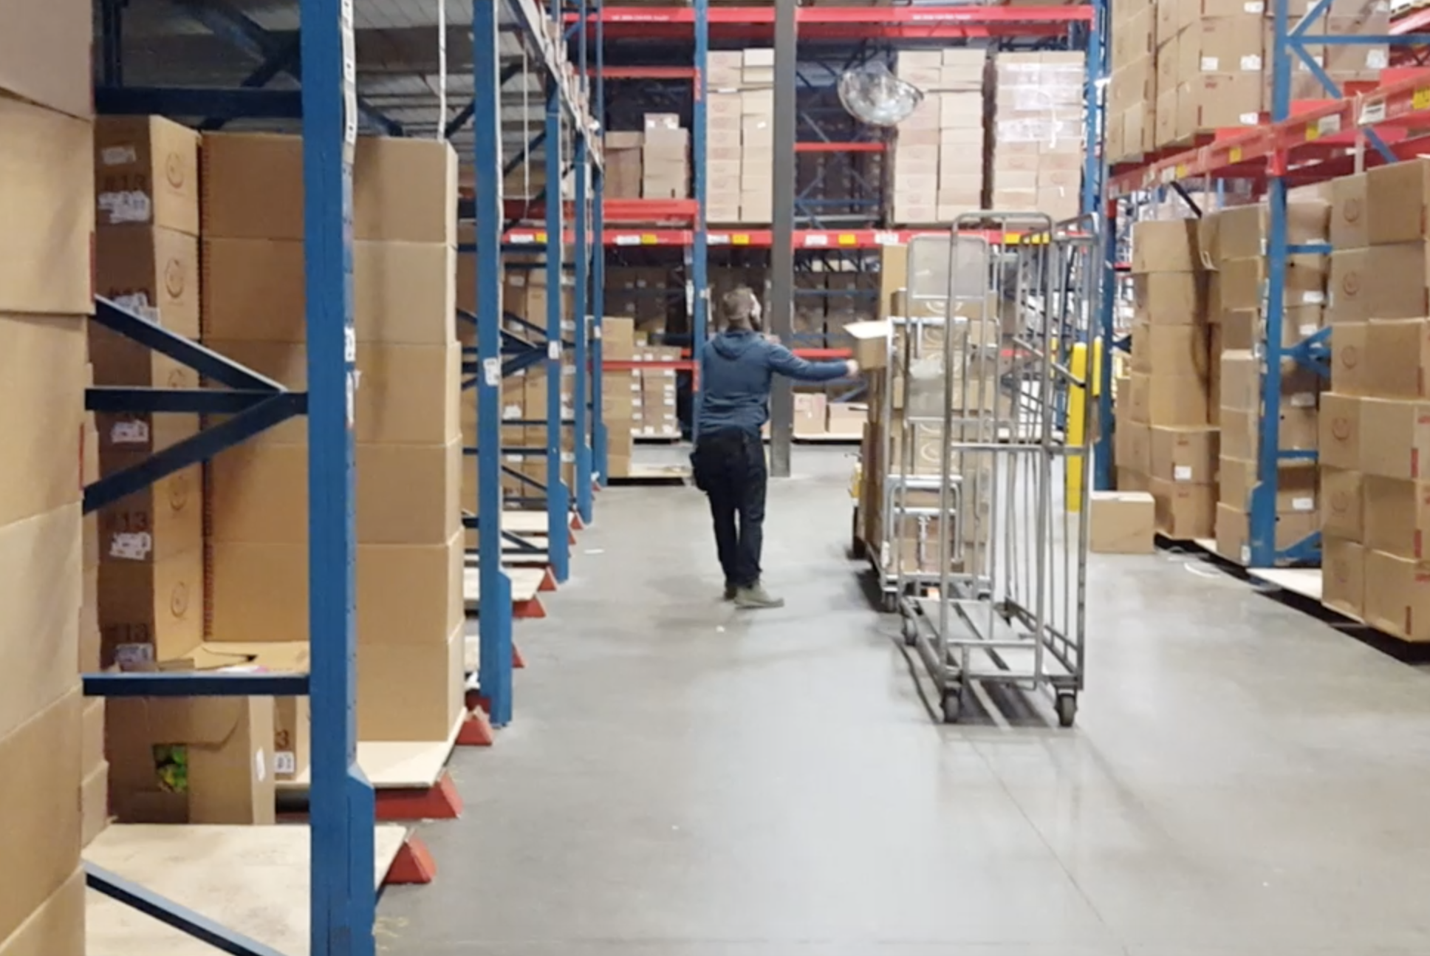


Problem Statement
Order in each (250 SKUS)
Distribution Center
Plant
Rural Bin
Order in full case

Slide 5

Problem Statement
Customer prefer order in each
A
B
Fit small chain stores’ demand better
More flexible supply and less waste
C
Competitive edge
Higher profit
Customer satisfaction

Slide 6

Problem Statement
Project goal: develop an optimization tool that helps region sales directors to improve SKU selection
Old Approach
New Approach
Director manual selection
Mainly consider speed of sales and amount of return
Decentralized method
Machine automatic selection
Take distribution cost, innovation, category… into consideration
Centralized method, the tool can be generalized to every region

Slide 7
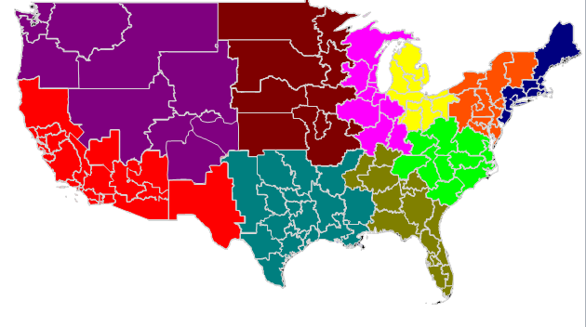
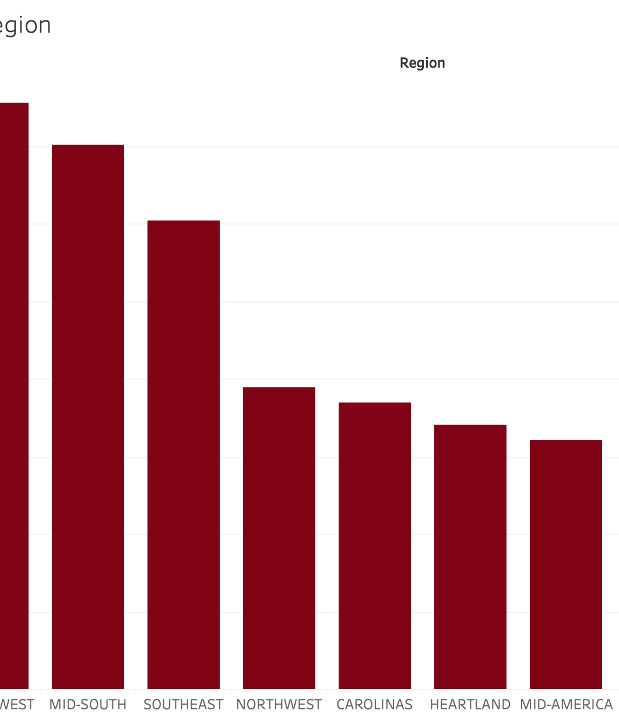
Data Exploration

Slide 8

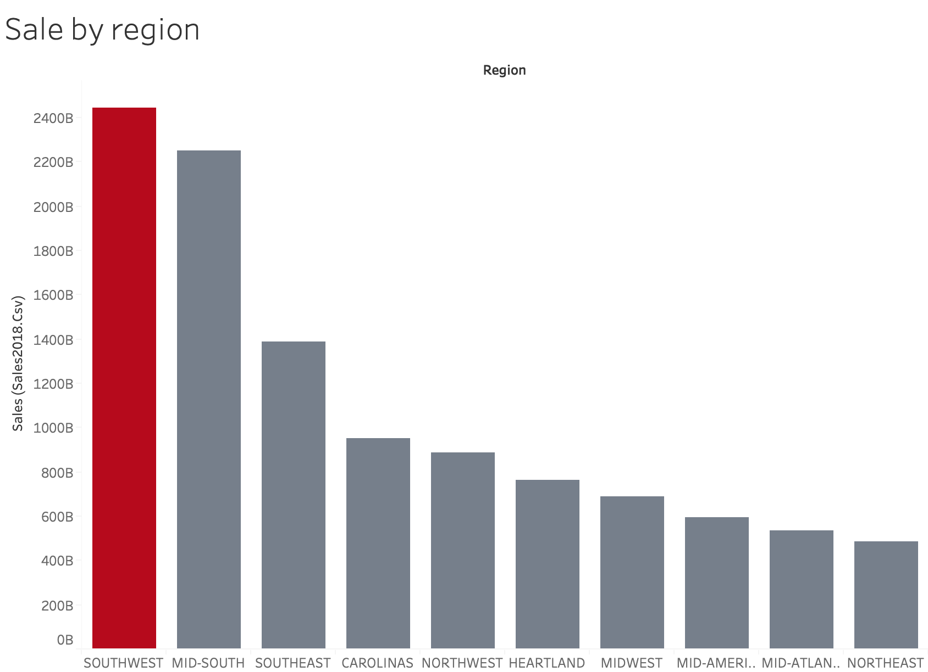
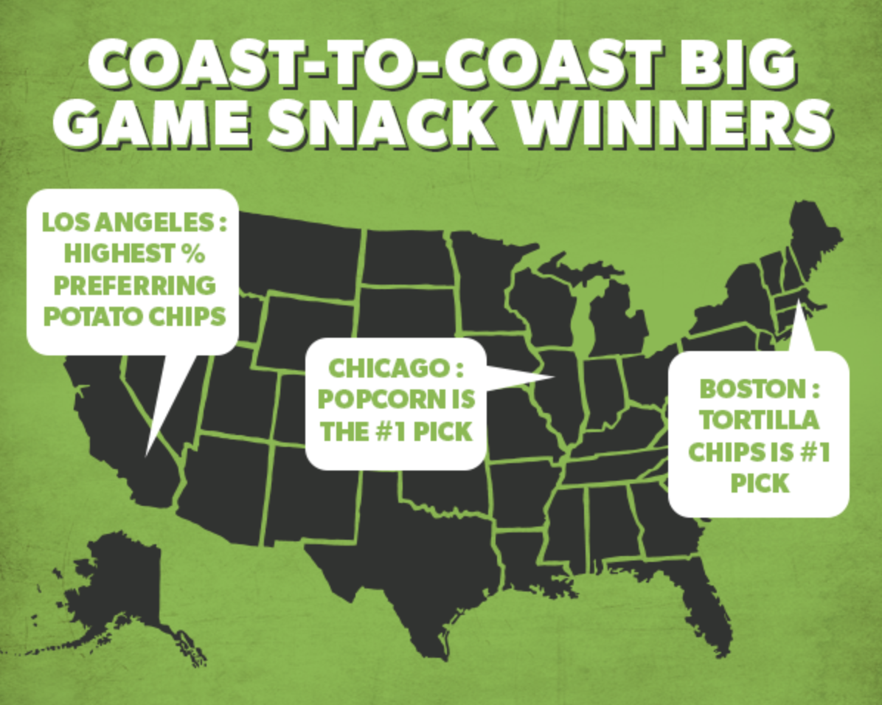
Data Exploration
Southwest region has the highest sale in 2018
Region

Slide 9
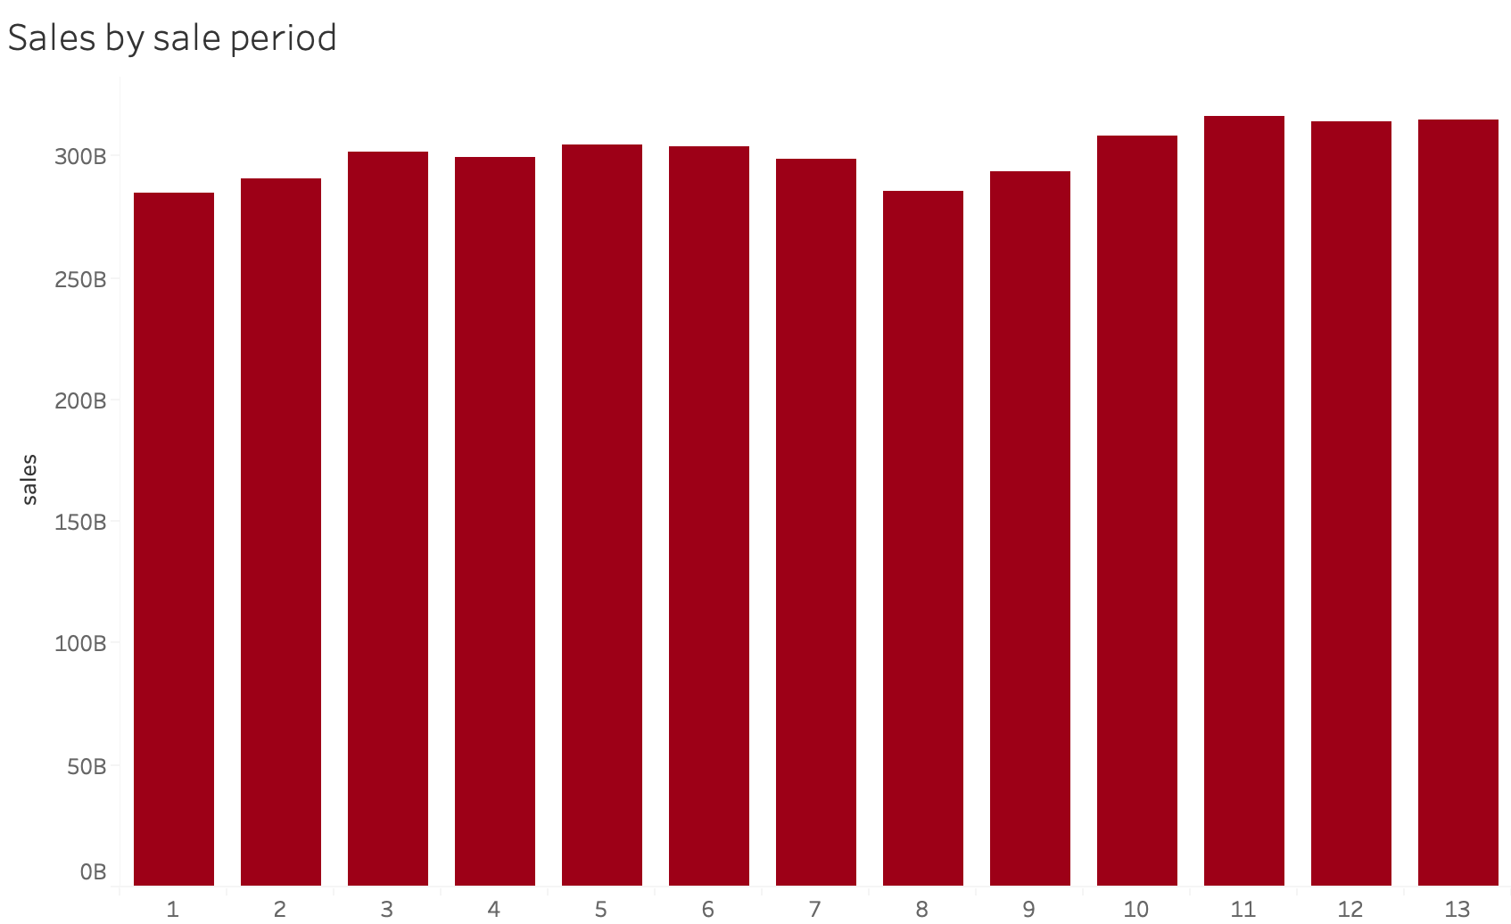
Data Exploration
No obvious seasonality in sales.
SKU selections are applicable for the whole year
Sale Period

Slide 10
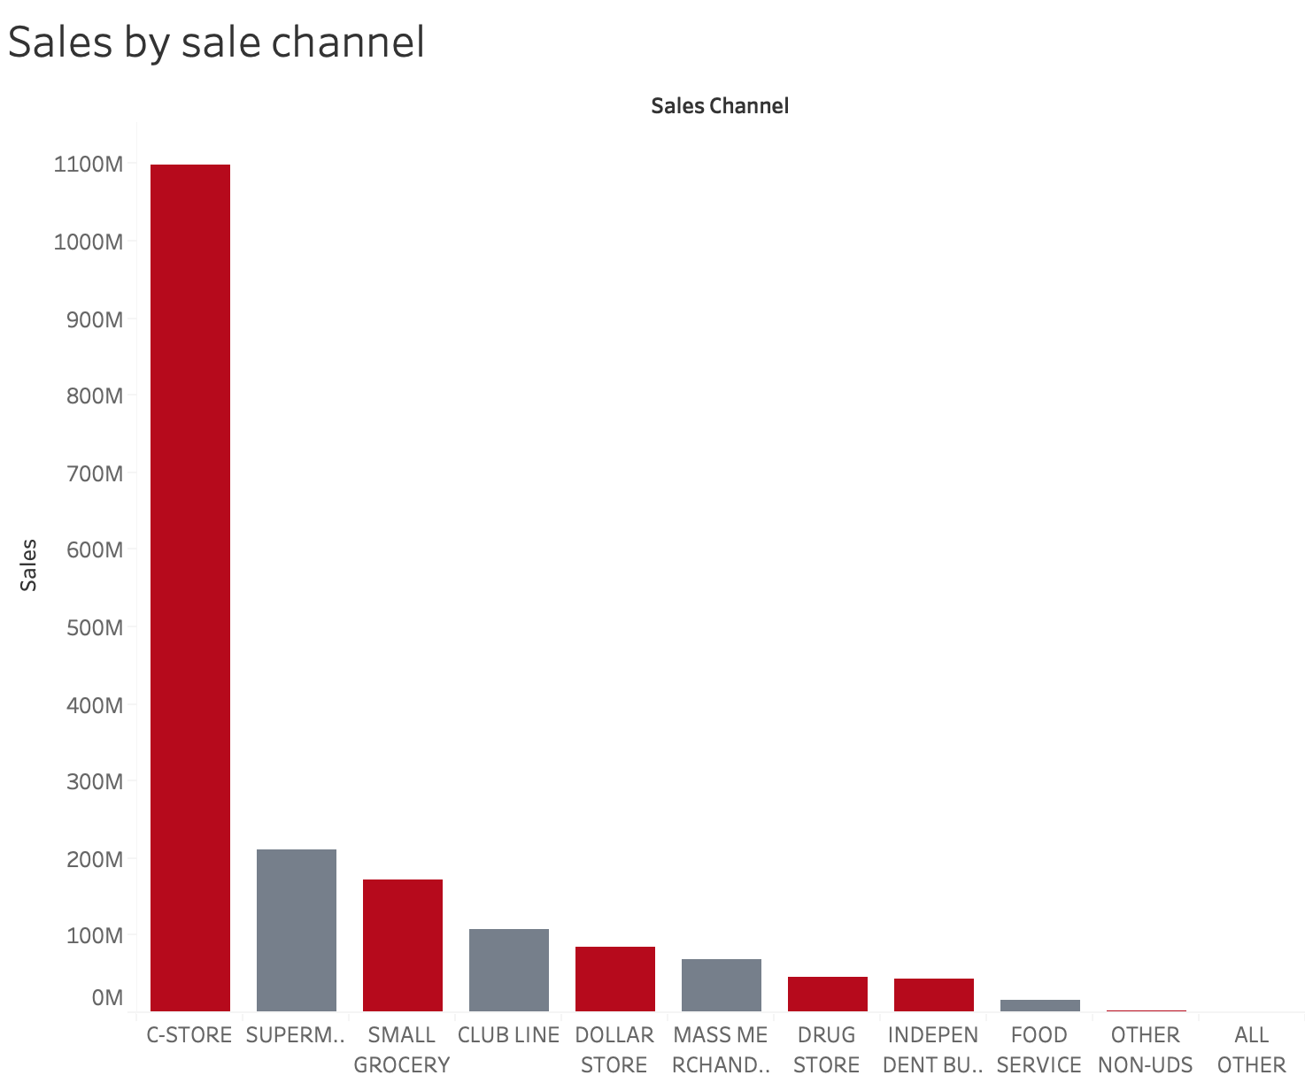
Data Exploration
Huge amount of sales are in the small format, which are delivered to sale channels such as convenient stores and small groceries.

Slide 11
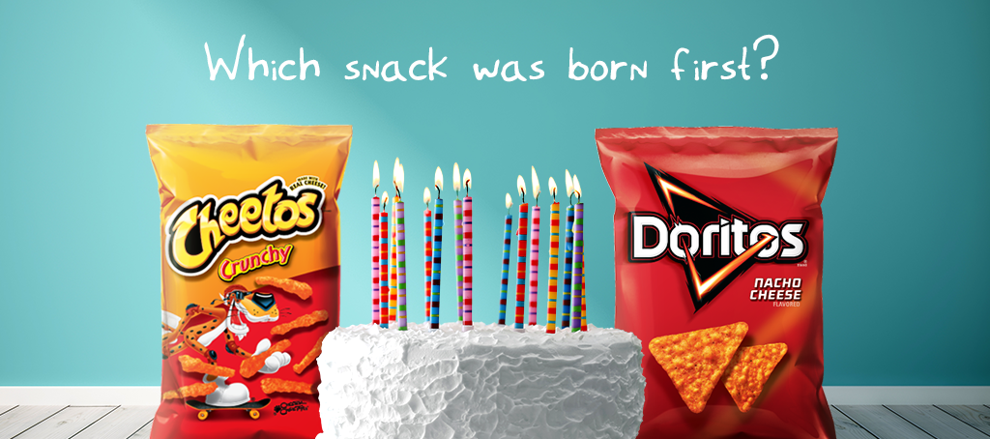
Model Explanation

Slide 12



Model Explanations
$$Quality Score=w_{s}×Sales−w_{r}×Returns− w_{d}×Distribution Cost+w_{m}×Margin−w_{p}×Capacity Penalty$$
Sample weight:
(can be customized)
1(base)
0.2
0.1
0.1
0.01
Each BDC has its own product quality score.
Our goal: maximizing total quality score under constraints
Decision: which BDC to carry in each sale region

Slide 13
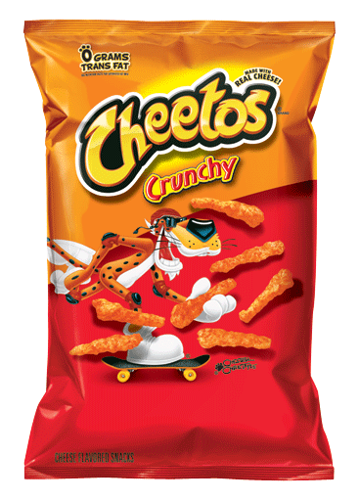
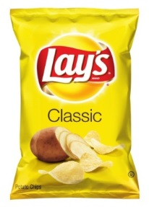


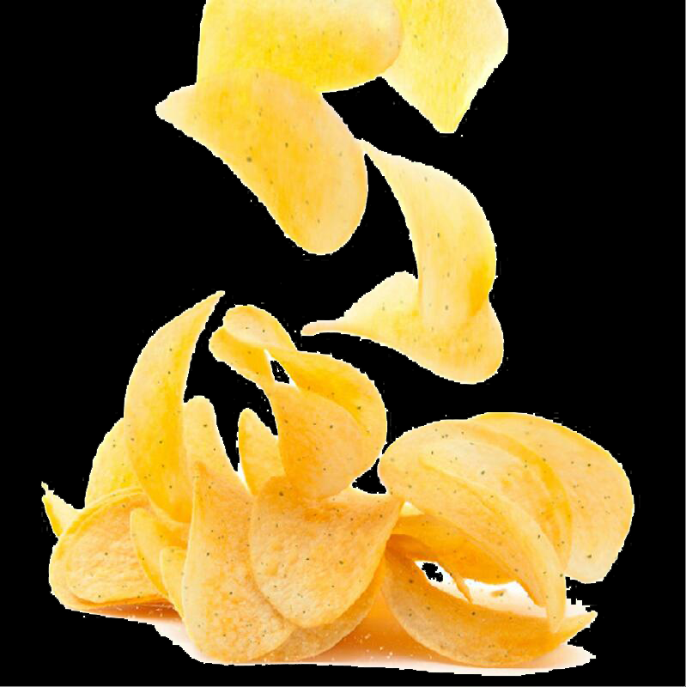
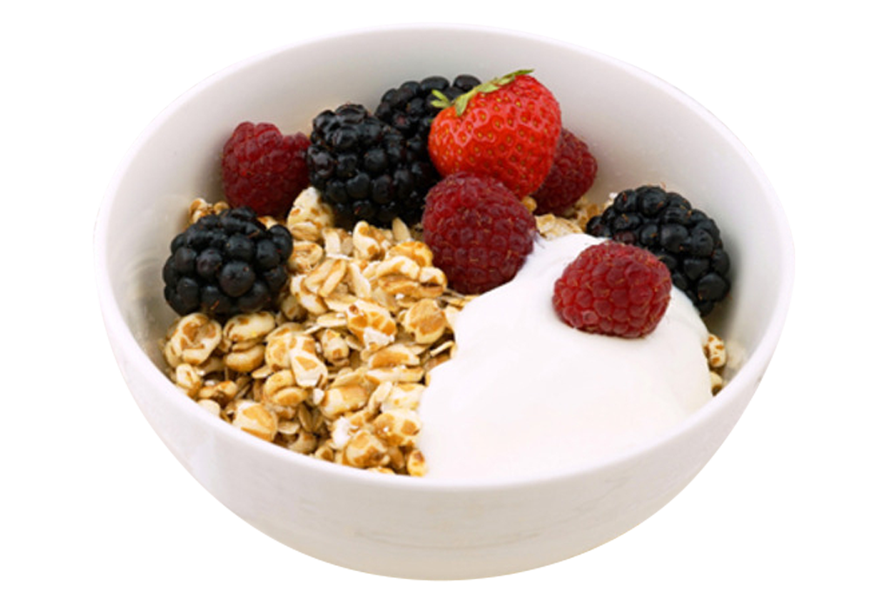
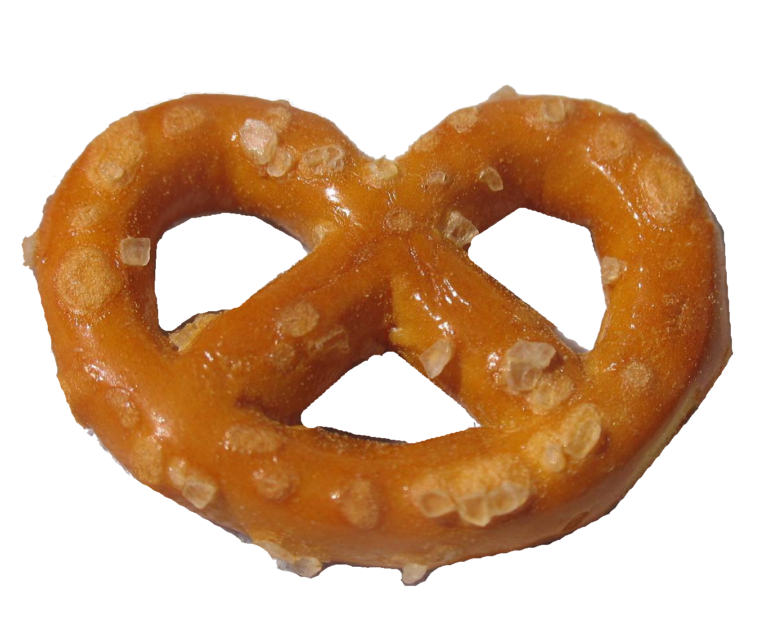
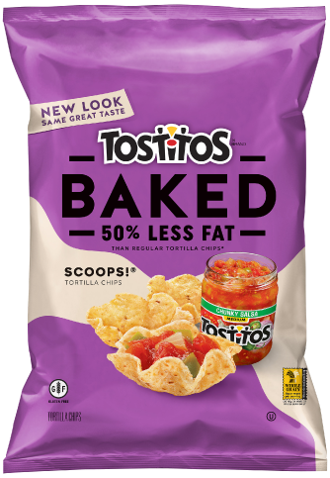
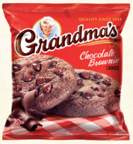
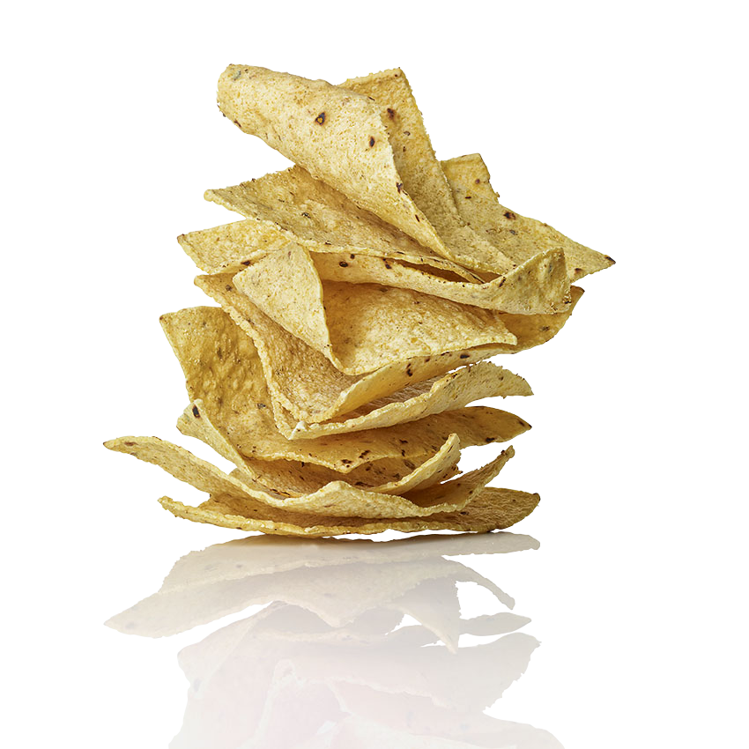
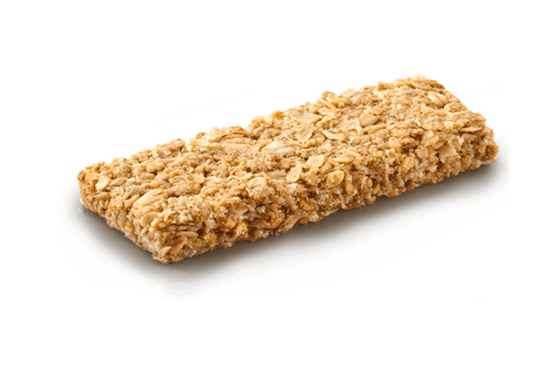
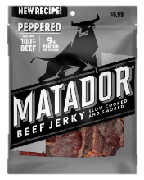
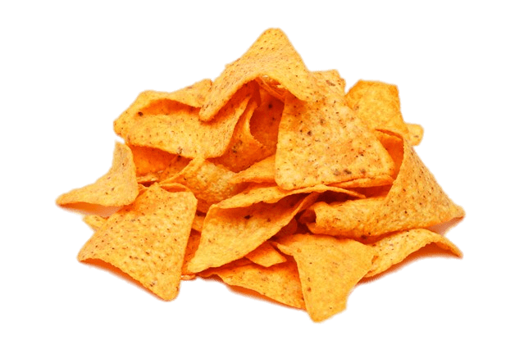
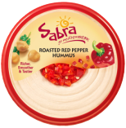
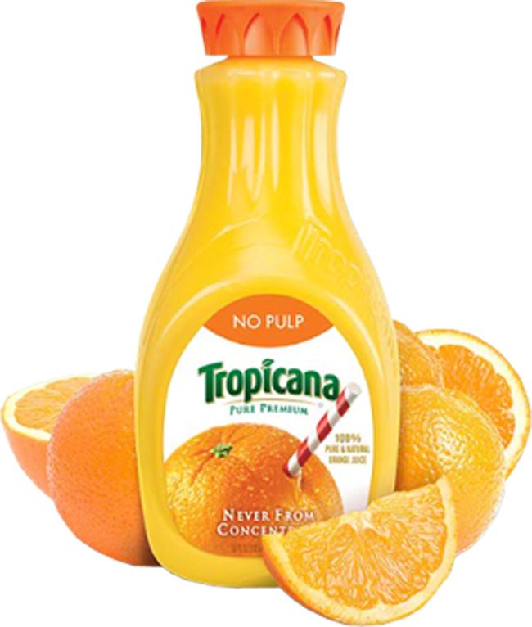
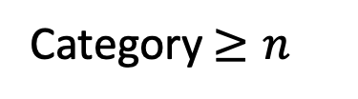
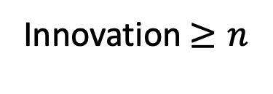
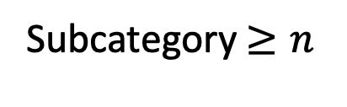
Model Explanations
1036 skus
250 skus
Subcategory$≥n$
Category $≥n$
Innovation $≥n$

Slide 14

Model Explanations
Input
Product Quality Score
Generated from original data sets:
Sales
Return
Margin
Distribution cost
Platform Capacity
Customization data
Weight in quality score calculation
Minimum requirement on innovation products
Minimum requirement on each category
Minimum requirement on each subcategory
Output
250 SKUS

Slide 15

Result Interpretation

Slide 16
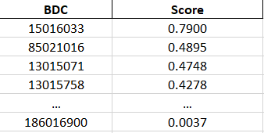
Sample Output Data
Total Score:
21.9120

Slide 17
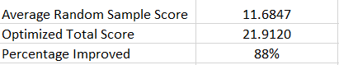
Quality Score Comparison
250 SKUS randomly selected from all BDC
Calculate the total quality score
Repeat the process 100 times
Calculate the average total score of 100 random sample scores
Compare quality score between random selection and optimized selection

Slide 18
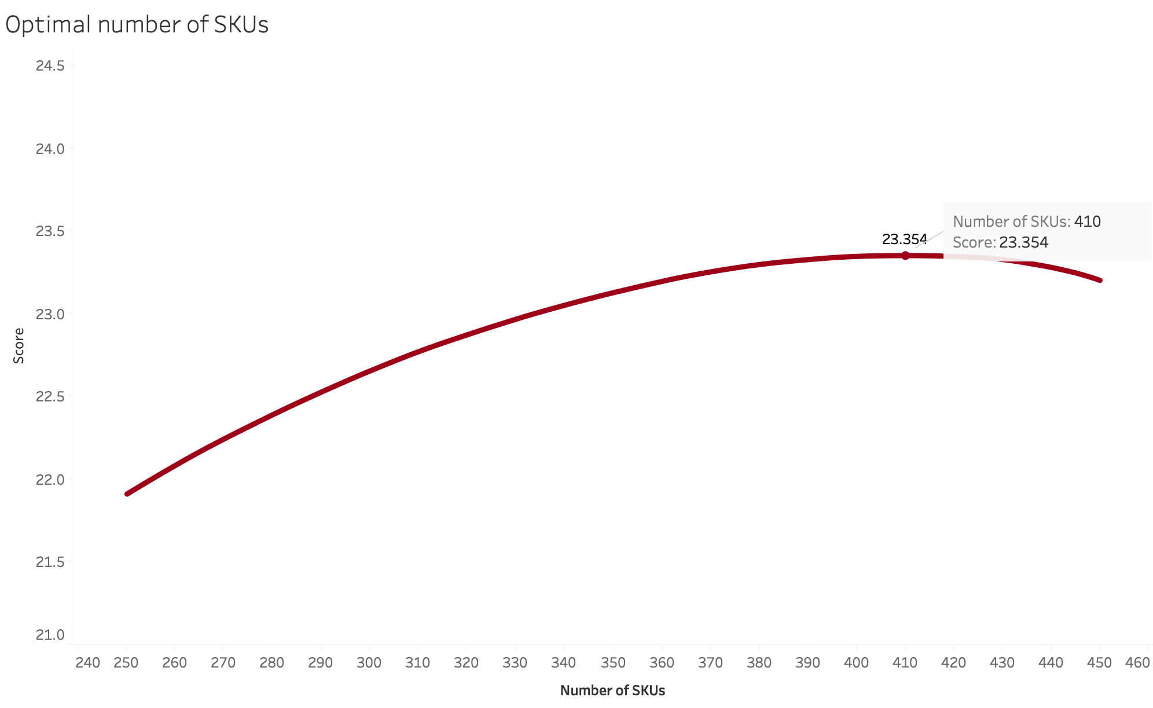
Further Exploration
250 might be not enough
Increase the number of SKUs in the small format?

Slide 19
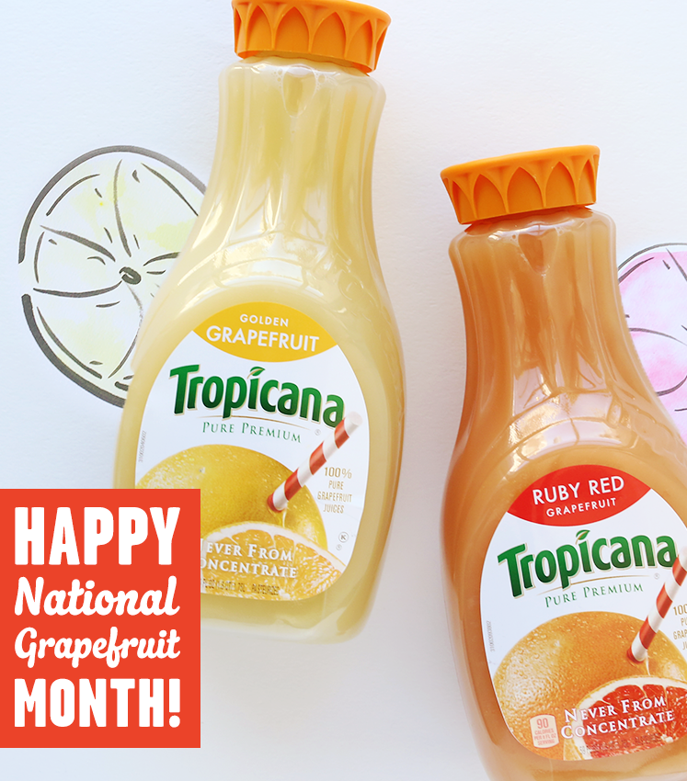
Future Improvement

Slide 20
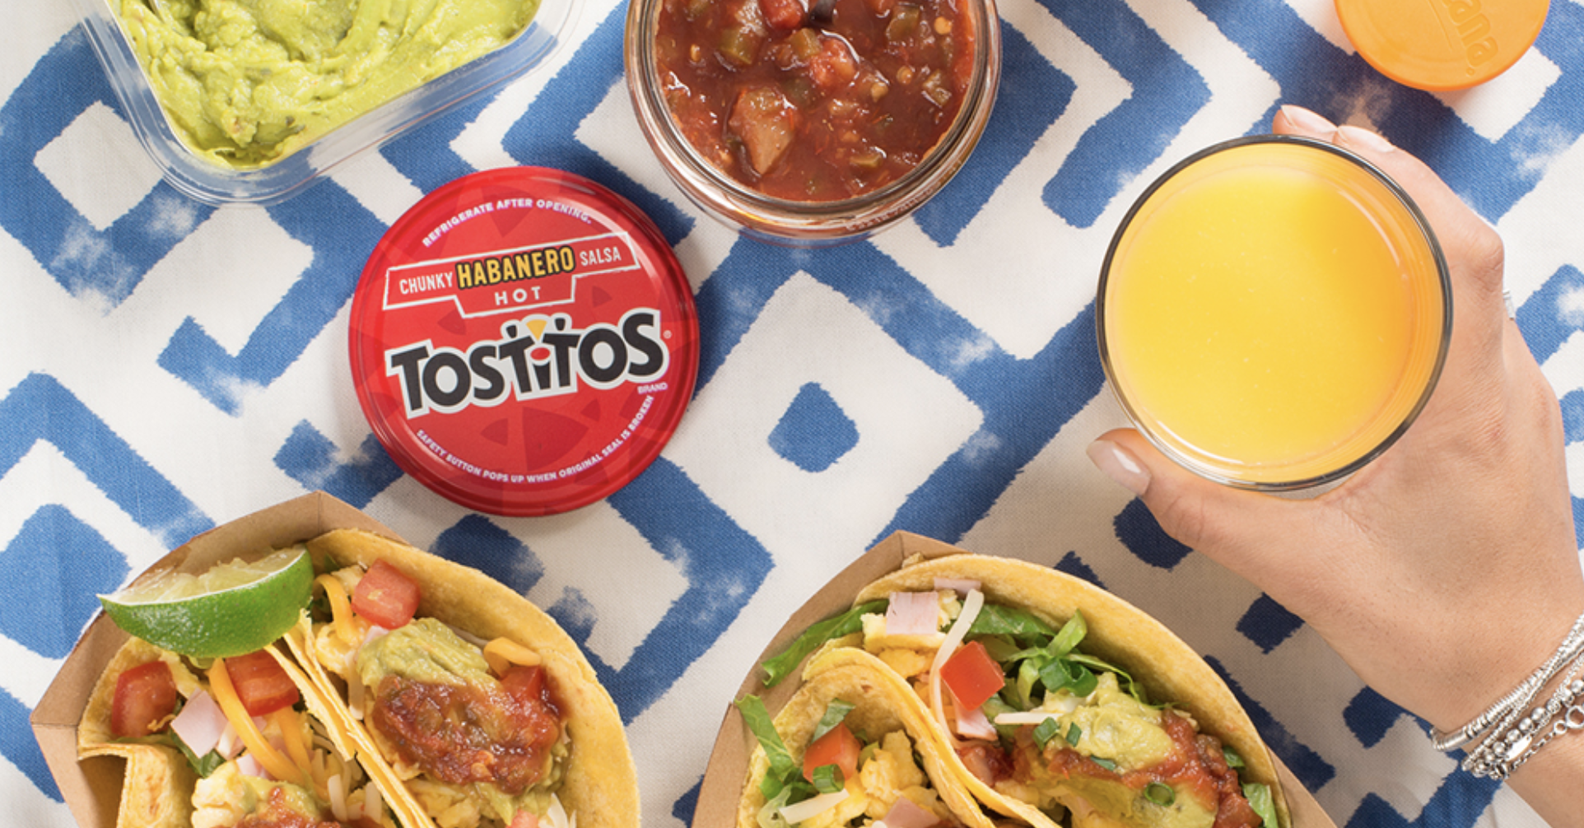

Product Quality Score Improvements
Tool Perspective
Heavily dependent on the weight selections
Optimization Assumptions

Slide 21

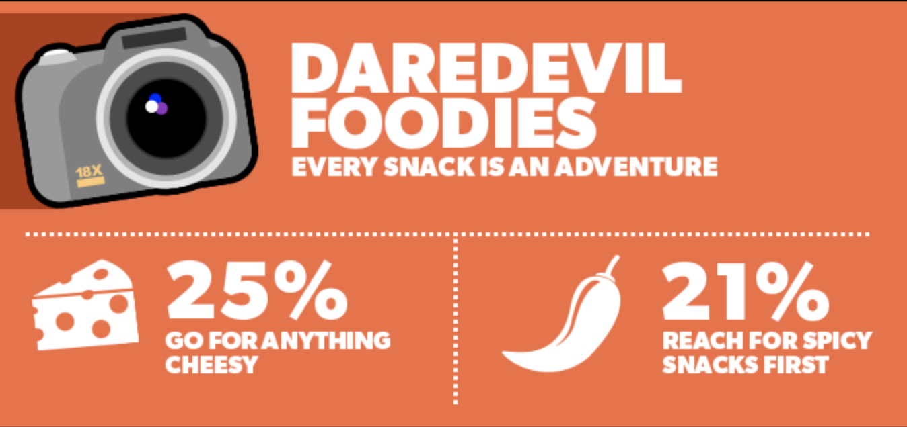
Product Quality Score Improvements
Business Perspective
Flavor incentive score
Competitor Score

Slide 22

Thank You!! Any Questions?

